Slide 1
Ground Tournament 1 Team Presentation August 3, 2015
Alpha CubeSat
Don’t wait for the future, help us build it!

Slide 2
GT-1 Presentation Outline
Total Presentation Time is 55 minutes and will be strictly enforced.
Section | Allotted Time in minutes | Team Presentation - Outline
Introduction 5 minutes 2-3 Slides | 5 | Team photo; Team member roles; Currently vacant team functions; Plan to fill gaps; Prize-winning characteristics of your team
Winning Plans 25 minutes 2-8 Slides | 15 | ConOps walkthrough; CubeSat block diagram
 | 10 | List of in-space prizes your team will win; Why and how your team will win in-space prizes
Development Plan 20 minutes 4-11 Slides | 5 | Schedule – Details to GT-2; Milestones to launch
 | 5 | Programmatic Risks –– Cost, Schedule, skill mix; 5x5; mitigation plan
 | 5 | Cost Factors - Cost to complete; Fundraising plan
 | 5 | Technical Risks –– Comm link, propulsion & navigation, longevity; 5x5; mitigation plan
Contingency Time 5 minutes 1 Slide | 5 | Contingency – if any topics above exceed time budget
Total Duration | 55 | 55 minute total time limit, strictly enforced

Slide 3
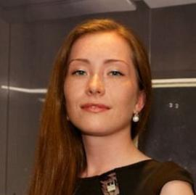
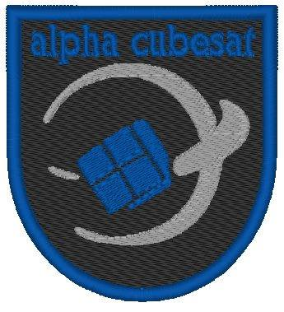
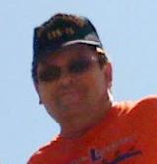
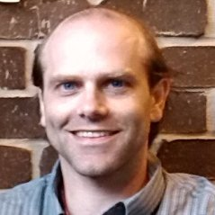
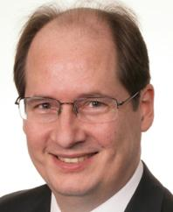
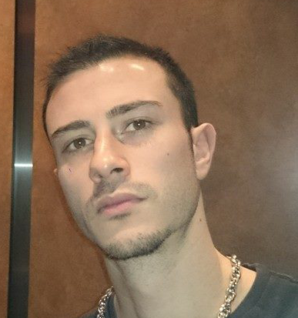
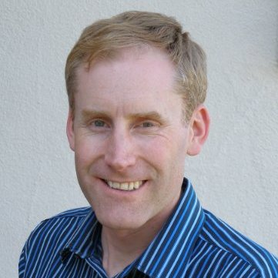
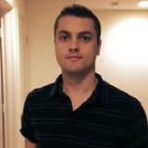
Introduction - Team Alpha CubeSat Photo

Slide 4
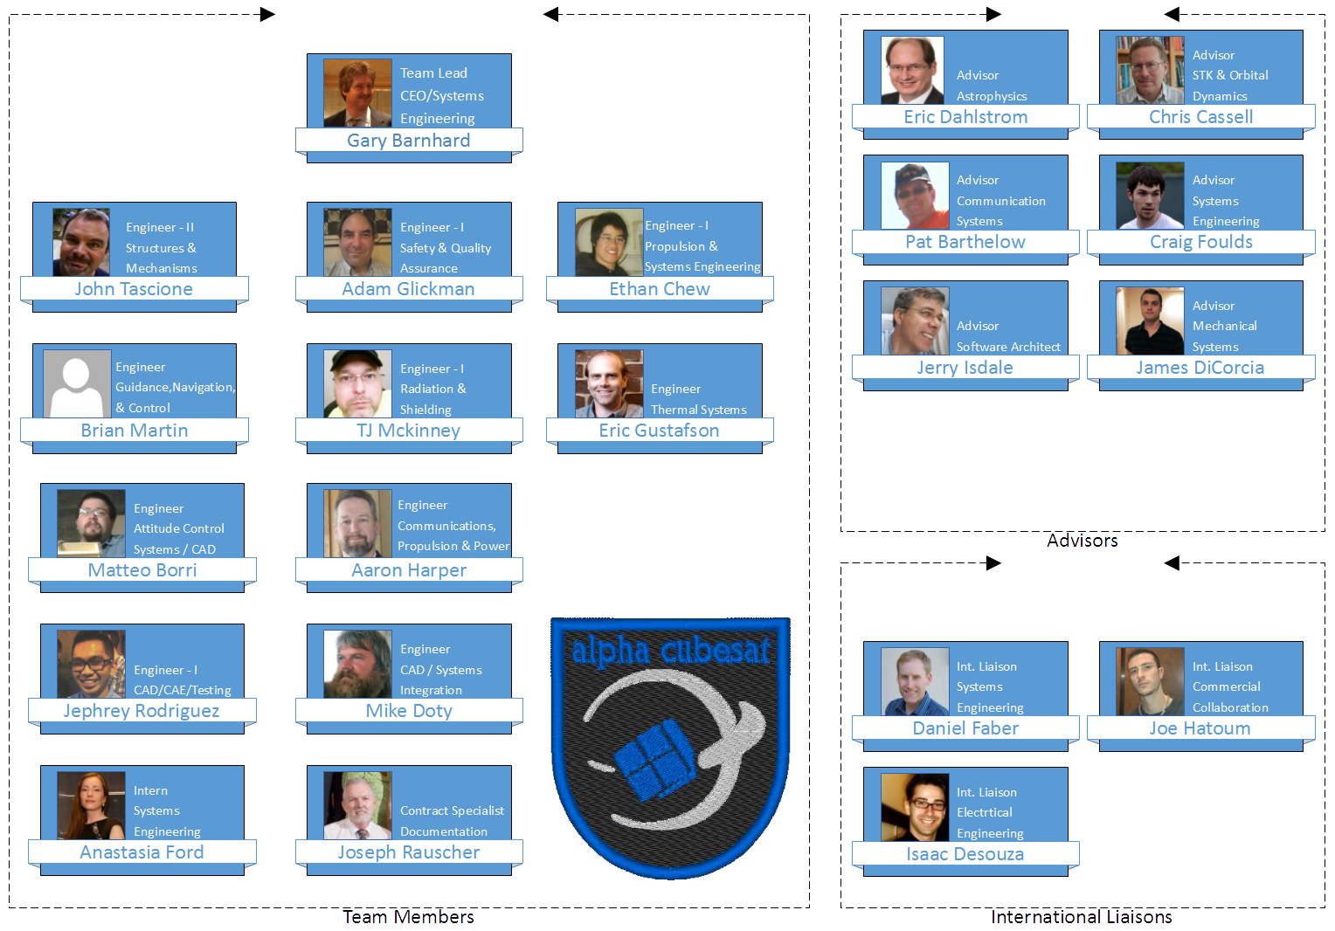
Introduction - Team Alpha CubeSat Roster

Slide 5
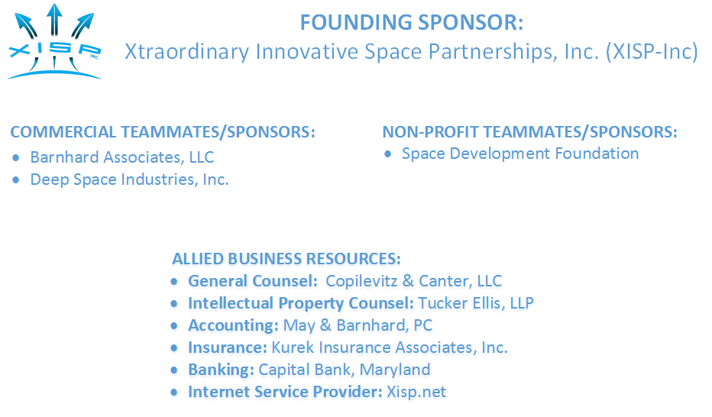
Introduction - Teammates/Sponsors, et.al.

Slide 6
Introduction - Team Member Roles
Describe some your team’s qualities, characteristics, experience, and capabilities that enables your team to deliver a winning mission:
Our team brings together an extraordinary combination of proven systems engineering talent, specialized discipline skills, and a shared commitment to build a mission of enduring value.
Team Member Name | Role
Gary Barnhard | Team Leader, CEO/Systems Engineering Lead
Matteo K. Borri | Attitude Control System Lead
Ethan Shinen Chew | Propulsion System Lead, Systems Engineering Whip
Mike Doty | CAD/Systems Integration Lead
Anastasia Ford | Systems Engineering Intern
Adam Glickman | Safety & Quality Assurance Lead
Eric Gustafson | Thermal System Lead
Aaron Harper | Communications System Lead, Propulsion & Power
Brian Martin | Guidance, Navigation & Control Lead
TJ McKinney | Radiation & Shielding
Joseph Rauscher | Contract Specialist/Documentation
Jephrey Rodriguez | CAD/CAE/Testing
John Tascione | Structures & Mechanisms

Slide 7
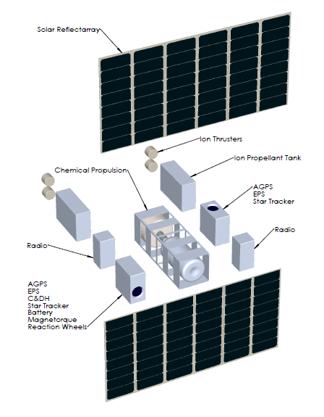
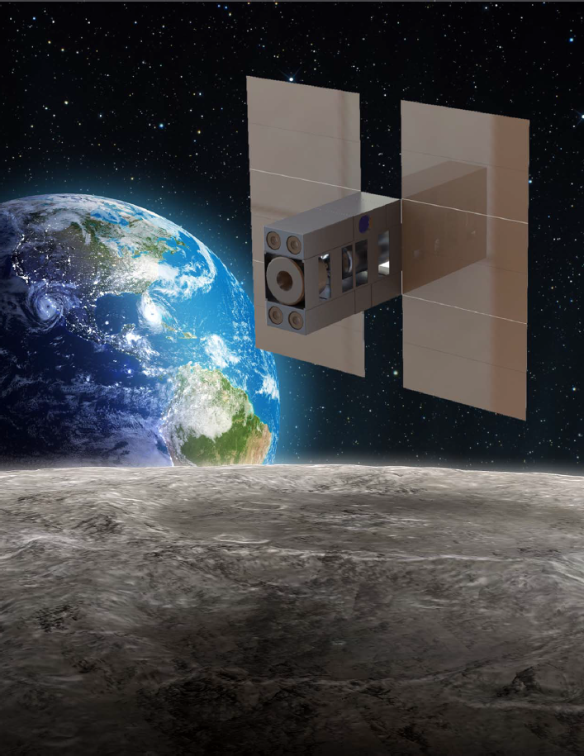
Winning Plans - Alpha CubeSat

Slide 8
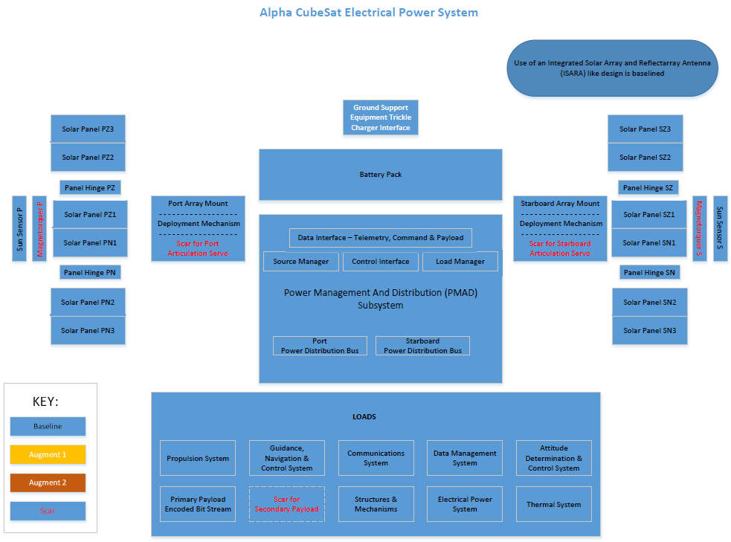
Winning Plans - Alpha CubeSat EPS System

Slide 9
Winning Plans - ConOps Walk Through
Completely describe ConOps, from delivery and integration with LV, to deployment, and through Deep Space Derby and/or Lunar Derby, until CubeSat disposal
The Alpha CubeSat baseline is the timely delivery of a SLS SPUG compliant payload for SLS EM-1 Integration and Launch operations.
The option of a commercial cargo launch with/ISS deployment is being maintained as a mission alternate. If used Unpack, Transition, Relocate & Position operations are added.
Deployment is via a Planetary Resources Dispenser (in both cases). Deployment timing will be requested to achieve a optimal transition to the desired alternate minimum energy deep space trajectory.
Final Checkout operations are planned prior to Trajectory Insertion
A combination of low thrust long duration, and high thrust short duration propulsion subsystems will be used to achieve trajectory insertion, and sequenced in-flight maneuvers.
Initialization of Deep Space Derby operations begins with stablization of attitude and establishing actual trajectory, followed by optimizing trajectory & test of all systems. Competition transmissions will be initiated once navigation bits are verified.
Initialization of Lunar Derby operations begins with stablization of attitude and establishing actual trajectory, followed by optimizing trajectory & test of all systems. Competition transmissions will be initiated once navigation bits are verified.
Initialization of End 0f Life operations begins with stablization of attitude and establishing actual trajectory, followed by optimizing trajectory & test of all systems in support of targeted lunar impact.

Slide 10
Winning Plans - ConOps Walk Through
Alpha CubeSat will use the latest version of the NASA ARC Open Source Mission Control Technologies (MCT) Suite (a.k.a, WARP) as extended by XISP-Inc to include a near realtime state model/management capability to support both ground and in-space operations.
WARP is a web based tool set/application framework that is highly compatible with the structured command sequence verification and validation approach anticipated for Alpha CubeSat.
The same software suite will be used to support all subsystem and system testing, and will iteratively and recursively augmented to support each new level of work operations.
Operations control is anticipated to be run from the DSI/XISP-Inc Colab in the NASA ARC Research Park or linked facilities in parallel with other missions that are anticipated to be operating at the time.

Slide 11
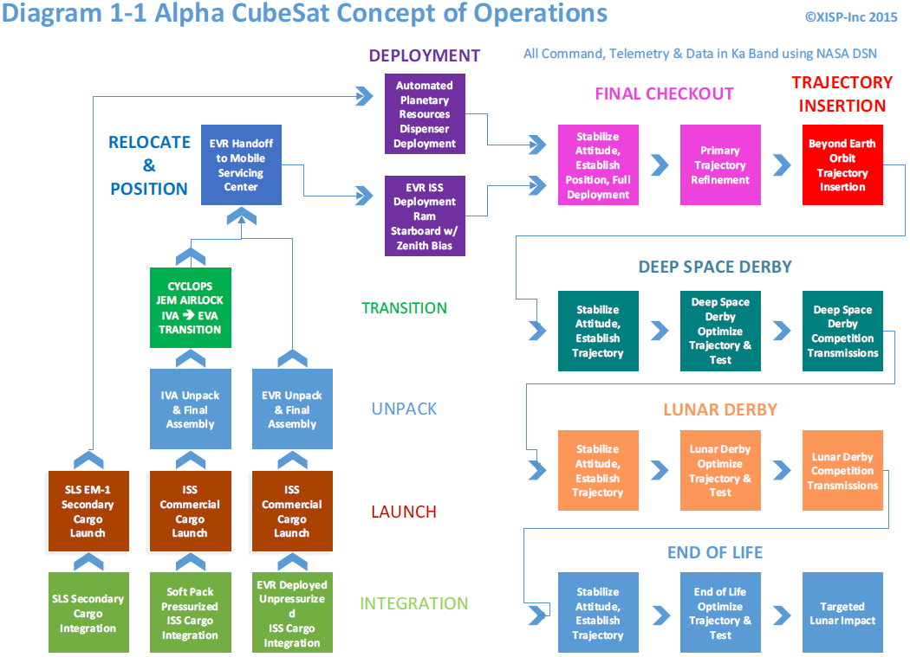
Winning Plans – CubeSat Block Diagram

Slide 12
Winning Plan – In Space Prizes
List the in-space prizes that your team intends to win and the winning tactic/capability for each
Our team intends to win In Space Prizes in both the Deep Space Derby and Lunar Derby categories.
Deep Space Derby - alternate launch options, propulsion options, minimum energy trajectories
Burst Rate: Ka Band, Available Power & CPU Cycles, NASA DSN
Aggregate Data Volume: Ka Band, Available Power & CPU Cycles, NASA DSN
Spacecraft Longevity: Simplicity of design elements, redundancy, fault tolerance
Farthest Comm Distance: Driven by return trajectory requirements therefore TBD
Lunar Derby - - alternate launch options, propulsion options, minimum energy trajectories
Lunar Orbit: minimum energy resonance orbits
Burst Rate: Ka Band, Available Power & CPU Cycles, NASA DSN
Aggregate Data Volume: Ka Band, Available Power & CPU Cycles, NASA DSN
Spacecraft Longevity: Simplicity of design elements, redundancy, fault tolerance

Slide 13
Winning Plan – In Space Prizes
Provide a free-form description of operations strategy, tactics, CubeSat advantages and ground segment advantages that will enable your team to win Deep Space Derby and/or Lunar Derby prizes
Team Alpha CubeSat has taken on the CubeQuest mission as a systems engineering challenge. We are neither buying the prizes, nor trying to build our way to them on a trial and error basis.
We are defining and orchestrating a set of design elements that exist at Technology Readiness Levels that are arguably too low for inclusion in a science focused mission.
However, they have sufficient payoff potential that warrant their inclusion in a technology development mission that is not only enables meeting the CubeQuest challenge but supports use of the technology for future missions.
By leveraging already committed mission infrastructure development and resources we are able to take advantage of related ongoing work, replication economies of scale as well as focus our scarce development resources on the necessary design deltas.
Allotted Time – 10 minutes (slide may be copied for total of two slides)

Slide 14
Winning Plan – Thanks to RWF, et.al.

Slide 15
Development Plan - Schedule
Describe tasks in detail to be completed between registration date to GT-2
Mission Registration Data Package
GT1 - Conceptual Design Review Report & Presentation
Safety Review Phase 0/1 - Alpha CubeSat Payload Process Engaged and On-Track
Simulation to Proposed Hardware/Software Performance Synchronization Achieved with Positive Margins for all Systems, Trajectories, and other identified design considerations
All areas of cost, schedule, and technical risk identified, mitigation strategies defined, and all outlier risk elements mitigated
GT2 - Preliminary Design Review Report & Presentation
Describe major and minor milestones between registration date and launch date
GT3 - Critical Design Review Report & Presentation
Flight Hardware/Software Integrated and All System Tests Initiated
GT4 - Flight Readiness Review Report & Presentation
Safety Review Final
Flight System Delivery for Integration
Include any milestones between payload delivery and launch
Complete command sequence edge case analysis
Optimize command sequence to stable attitude and trajectory solution convergence
Dry run entire mission simulation with anomalous event recovery

Slide 16
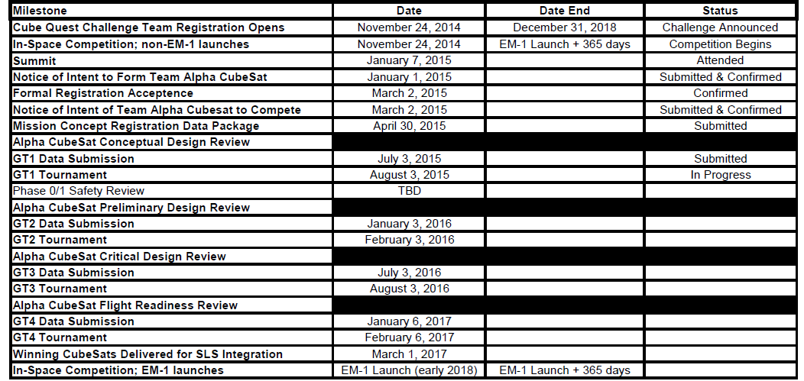
Development Plan - Schedule

Slide 17
Development Plan - Programmatic Risks
Identify your team cost risks, schedule risks, team skills mix/competencies risks & mitigation strategies
Goodwill: Availability of technical resources, materials, and equipment is predicated on maintaining goodwill between Team Members and Teammates/Sponsors, perceived mission value, and integrity.
We have to conduct business in a transparent, straight forward manner, deliver what we promise, and never promise more than we can deliver.
Margins: The necessary design robustness, margins, and technical interest to warrant the in-kind hardware/software investments needed must be defined and maintained to obtain and sustain sponsorships.
We will clearly define and document all trades and share our margin analysis with our sponsors on an ongoing basis
C-Value: Link to commercial world and perceived value of mission products drives down many elements of schedule risk, technical risk, and cost risk but will increase team critical path workload by driving out any available slack time/schedule margin.
Alternate launch option will be maintained, slack time/schedule margin claims must be mitigated by fungible resource/cash infusion.
Skill Mix: Team is growing and evolving with the work, but as the stakes and level of the work increases skill gaps & volunteer time limits becomes apparent.
internal education program has been defined, transition from from all volunteer to honoraria based on contribution & paid staff to fit workload is underway.

Slide 18
Development Plan - Programmatic Risks
Alpha CubeSat Programmatic Risk Matrix
Likelihood of Occurrence | Highest | 5 |  |  | Skill Mix |  | Goodwill
 |  | 4
 |  | 3 |  |  | Margins |  | C-Value
 |  | 2
 | Lowest | 1
 |  |  | 1 | 2 | 3 | 4 | 5
 |  |  | Lowest |  |  |  | Highest
 |  |  | Consequences of Occurrence

Slide 19
Development Plan - Cost Factors
Provide CubeSat costs, including materials, labor, tests, test facilities
Burn Rate Actuals Start-to-GT1 ~2048 hours, ~1 FTE / ~$225,000 In-kind & Cash Expenses
Burn Rate Projected Start-to-End ~ 8 FTE, ~ $1,000,000 Unmitigatable Labor & Other Running Costs
Value of donated hardware/software/tests/test facilities/tools/services projected to be between $1,000,000 to $5,000,000. Budget closure pending completion of design trades and buyoff by sponsors.
Use of the NASA DSN ground stations, aperture time, ground support equipment, data pass through, ground data systems, operations facilities, and labor is included in the above estimates. Low end costs assume parsimonious use of “just-right” sized DSN services and in general tag along, time available access to resources. Access on demand will drive costs towards the higher end.
Describe how team plans to cover costs, including contingencies
Budget will be under corporate management. Sponsors will be briefed on an ongoing basis. An aggressive social media outreach campaign to provide financial margin and provide opportunities for broader public and commercial engagement will be orchestrated by a reformed Public Affairs Team.
Outline how costs are phased, by quarter, from registration date until competition end and CubeSat disposal
Running costs ~$125,000 1st QTR 2015 - 1st QTR 2017, ~$18,000 QTR thereafter until EOL.

Slide 20
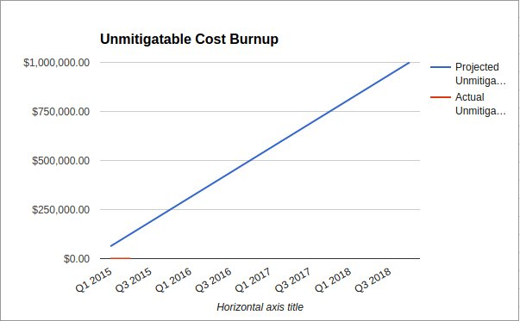
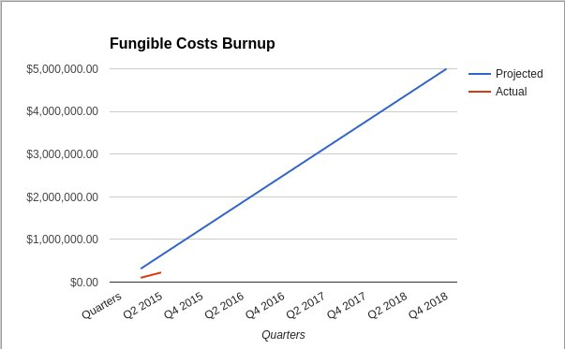
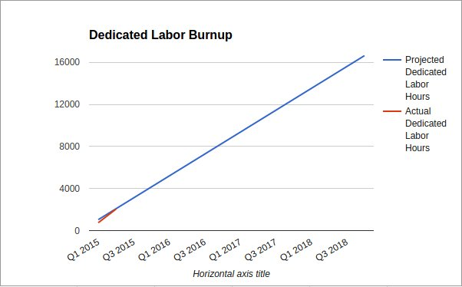
Development Plan - Cost Factors

Slide 21
Development Plan - Technical Risks
List of identified technical risks, included CubeSat and ground support equipment and functions
Ka Radio: Timely availability of suitable Ka Band Transceiver
Volume: Loss of volume margin due to system trade results
Heat: Thermal disconnect under competition loading
Radiation: Due to changes in trajectory radiation environment is materially increased
For each risk identified, show appropriate plans to mitigate
KA Radio: We are actively seeking multiple suitable Ka Band transceiver options.
Volume: The propulsion system components remain an active trade to address volume margin.
Heat: All available thermal management tools will be traded to provide thermal margin under loading.
Radiation: The radiation environment impact is being traded with propulsion, shielding, and other systems.

Slide 22
Development Plan - Technical Risks
Alpha CubeSat Technical Risk Matrix
Likelihood of Occurrence | Highest | 5 |  |  | Volume
 |  | 4
 |  | 3 |  |  | Ka Radio |  | Thermal
 |  | 2 |  |  |  | Radiation
 | Lowest | 1
 |  |  | 1 | 2 | 3 | 4 | 5
 |  |  | Lowest |  |  |  | Highest
 |  |  | Consequences of Occurrence

Slide 23
Conclusion
Thank you for your consideration
Questions can be directed to our team lead gary.barnhard@xisp-inc.com
Additional resources can be found via our website www.alphacubesat.com
Team Alpha CubeSat is not waiting for the future we are building it!

